Slide 1
Unit Converter in Python
Length, Temperature, and Weight Conversion
By: Team 4: Shrijal, Lubik, Sakar

Slide 2
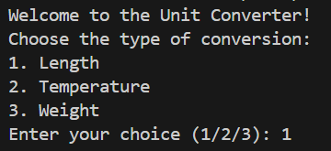
Program Overview
Console-based unit converter
Supports 3 conversion types:
Length
Temperature
Weight
User selects an option and enters a value

Slide 3
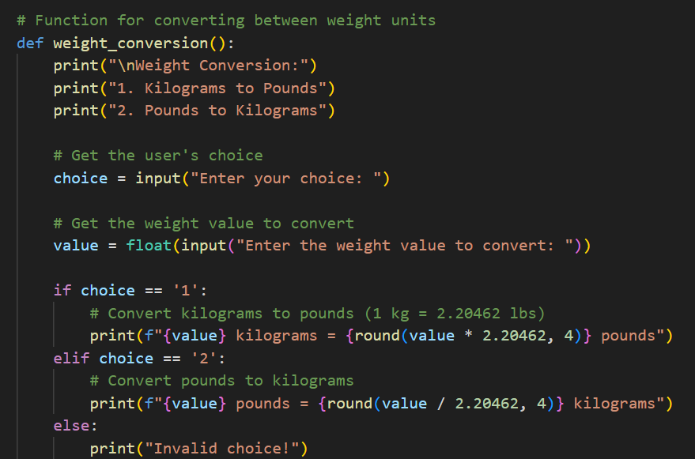
Features & Functions
Functions Used: length_conversion() temperature_conversion() weight_conversion()
Logic Flow: Menu → Input → Conditional
(if/elif/else)
Conversions Include: Meters ↔ Kilometers, Miles Celsius ↔ Fahrenheit Kilograms ↔ Pounds

Slide 4
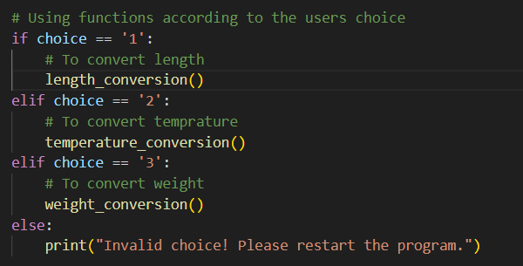
Concepts Used
input() / ) for user interaction
Functions for clean, modular code
if-elif-else for decision making
Simple arithmetic and formatting (e.g., f-strings)

Slide 5
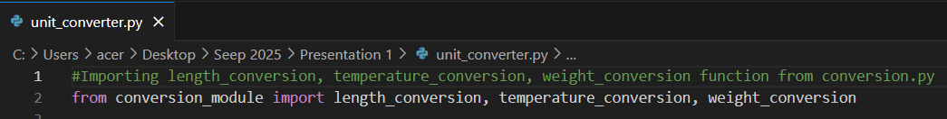
Limitation
Only able to convert :
Length Conversion
Temperature Conversion
Weight Conversion
Lack of GUI

Slide 6
Summary
Beginner-friendly Python project
Demonstrates real-world use of functions and user input
Can be extended with more unit types or a GUI

Slide 7
Thank You!
Any Questions?

